Slide 1

MARKETING PRESENTATION
Jaynette Mikki Ho 004D
http://thaitogo.sg
Notes:
Good day, everyone. Today, I’ll be sharing an exciting plan for enhancing ThaiToGo's business performance. Our goal is to drive significant growth and build on our success in the vibrant F&B landscape of Singapore.

Slide 2


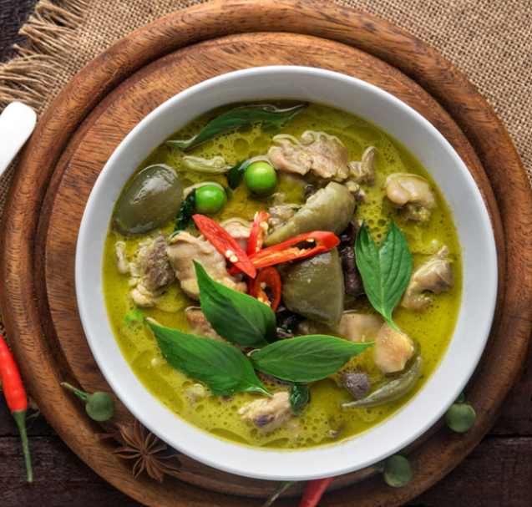
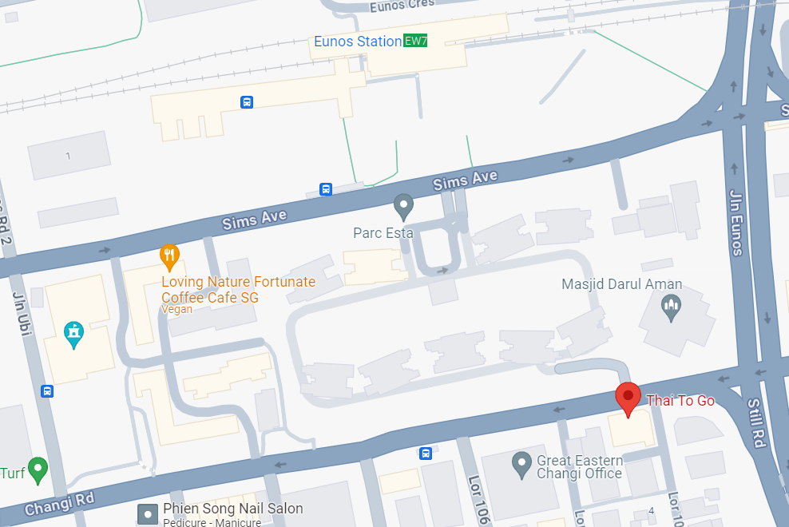

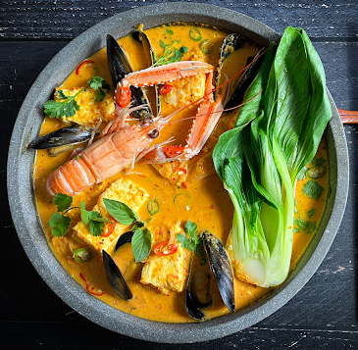
A TASTE OF THAILAND RIGHT IN THE HEARTLANDS OF SINGAPORE

Slide 3

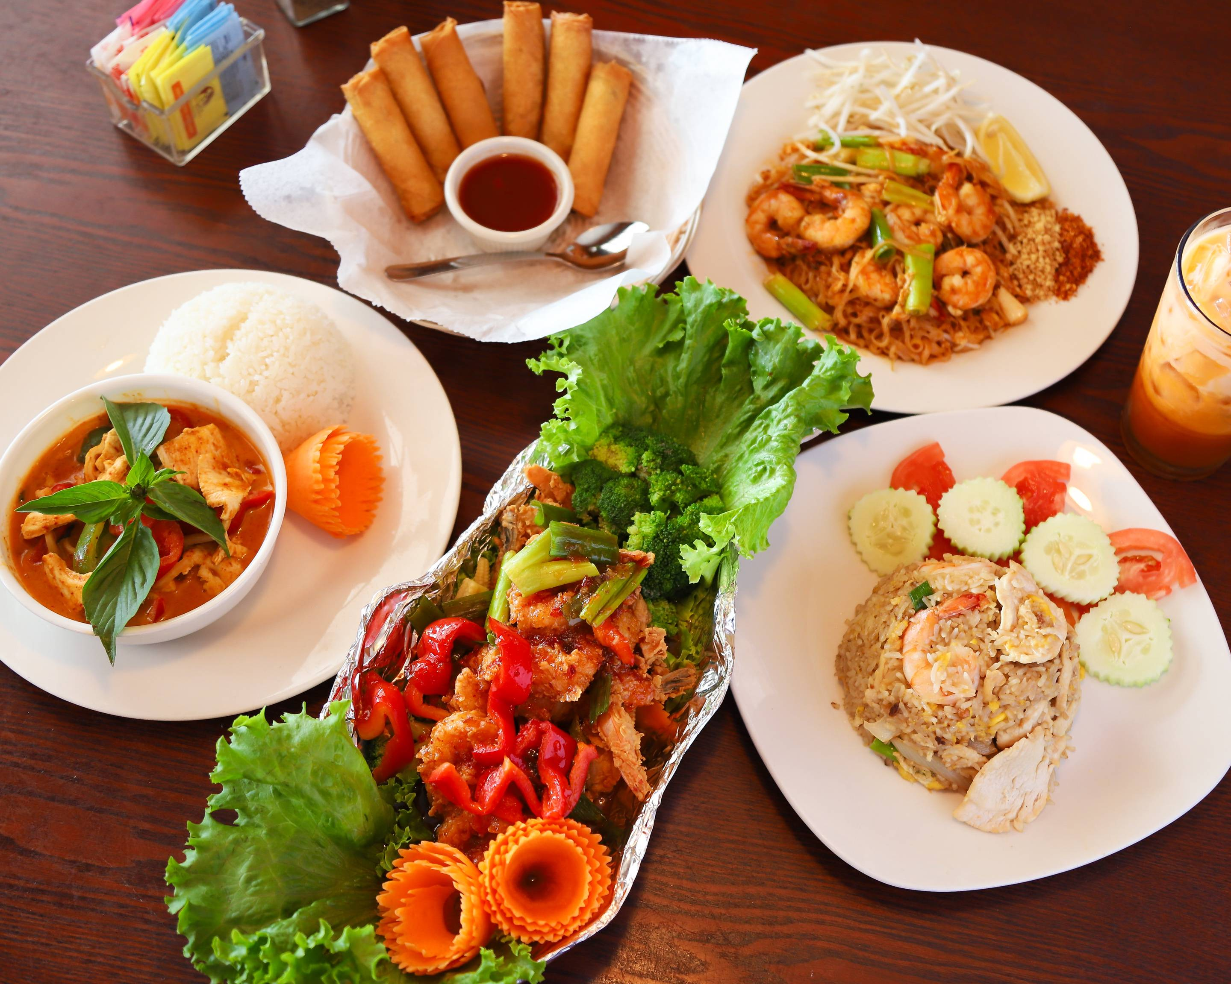
ThaiToGo
has been in business for a decade.
They offer
Order & Pickup
Island wide delivery
Dining in
Mini catering
Notes:
ThaiToGo has been a beloved destination for authentic Halal Thai cuisine in Singapore for over a decade. We offer a versatile range of services including dine-in, delivery, catering, and order & pickup options."

Slide 4
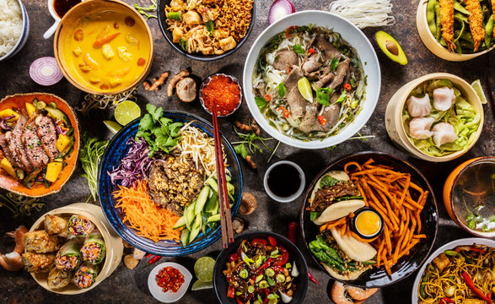
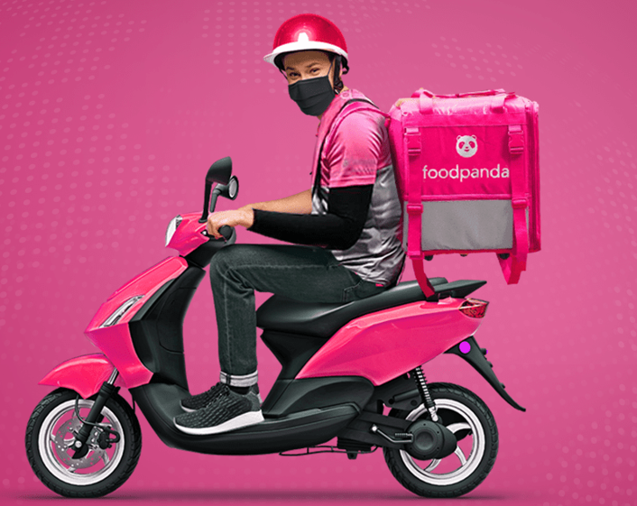
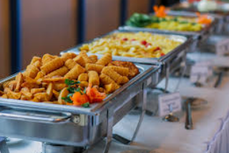
MENU
Dine-in
Online
Catering
Satisfy diverse palates with our
menu selection
Island wide delivery
Halal certified
In-Restaurant or Catering available

Slide 5
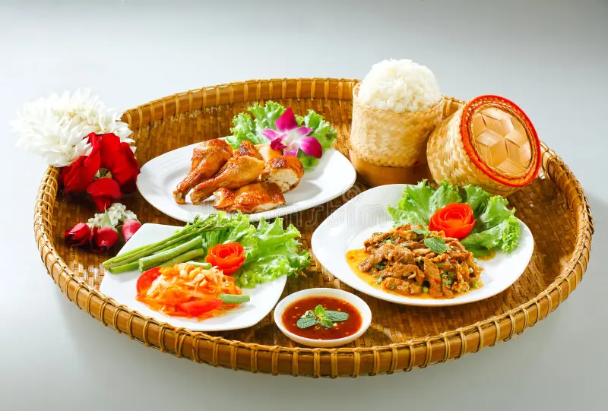
Unique Value Proposition
ThaiToGo is a Halal Thai restaurant offering Authentic Thai cuisine with a modern twist.
Has Fusion Thai, Malay & Western Menu
Recipes & Taste catered towards locals
Very flexible menu depending on what the customer wants (bento box, lunchset etc)
40 seater capability restaurant that can host parties, gatherings, parties by just ordering at least 20 pax

Slide 6


MARKETING PLAN

Slide 7
EXECUTIVE SUMMARY
Business Objectives:
To Increase Walk-in Customers by 20% in 6 months
To Increase Delivery orders by 20% in 6 months
Target Market:
Low-Mid income (Single or Married - with or without kids)
Who have a busy schedule and don’t have time to cook or doesn’t cook.
Who enjoy Dine-out with friends/Families.
Prefer to order takeout/delivery.
Market Need:
Affordable price
Halal Food (Nearby Mosque)
Product Overview:
Allow customers to customize their food to their needs
Variety of choices (Thai, Local, Western)
Notes:
- *Business Goals*:
- "Our primary objective is to increase both delivery orders by 20% over the next 6 months."
- *Target Market*:
- "We are focusing on busy low-mid income, both single and married, who value convenience and enjoy authentic, high-quality cuisine."

Slide 8
Marketing Strategy
Industry Analysis:
Trends: The demand for ethnic cuisine, particularly Thai food is growing due to its unique flavors and healthy options. The trend towards takeout and delivery services is also increasing.
Consumer Preferences: There is a preference for authentic,, high-quality ingredients, quick service, and convenient ordering options.
b. Competitor Analysis:
Competitors:
Pattaya Garden Restaurant
Jai Thai Restaurant (Also known as Jai Siam Restaurant)
Notes:
There is a growing trend toward takeout and delivery services.
We are competing with well-known establishments like Pattaya Garden Restaurant and Jai Thai Restaurant, both of which have strong online presences and dedicated customer bases.

Slide 9
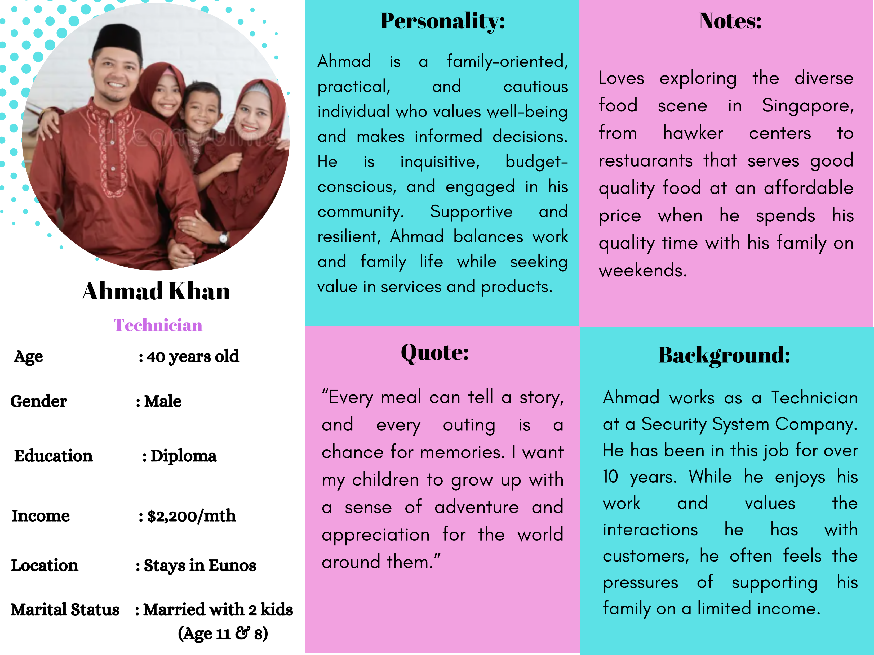
CUSTOMER PERSONA

Slide 10
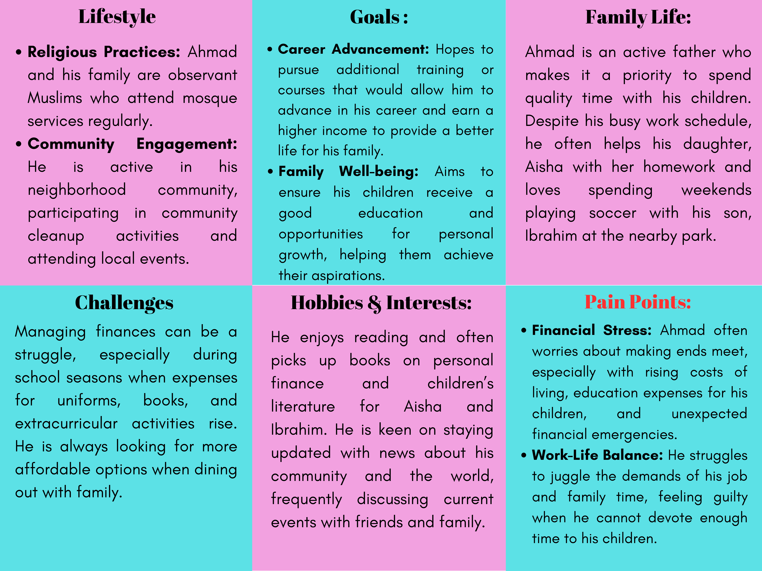
CUSTOMER PERSONA

Slide 11
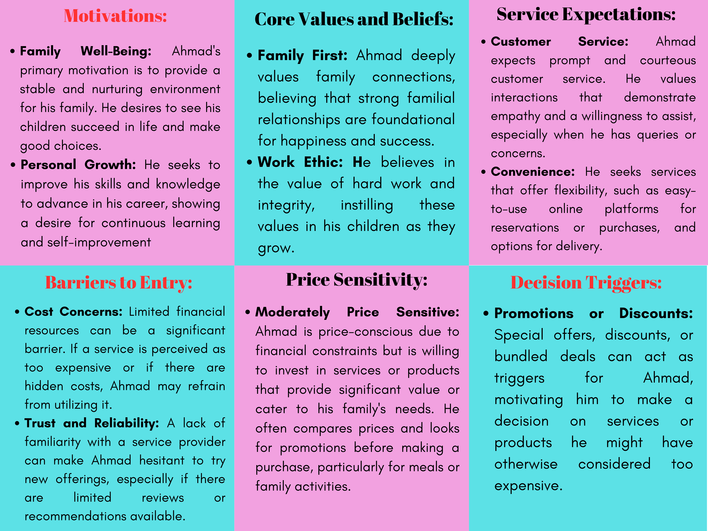
CUSTOMER PERSONA

Slide 12
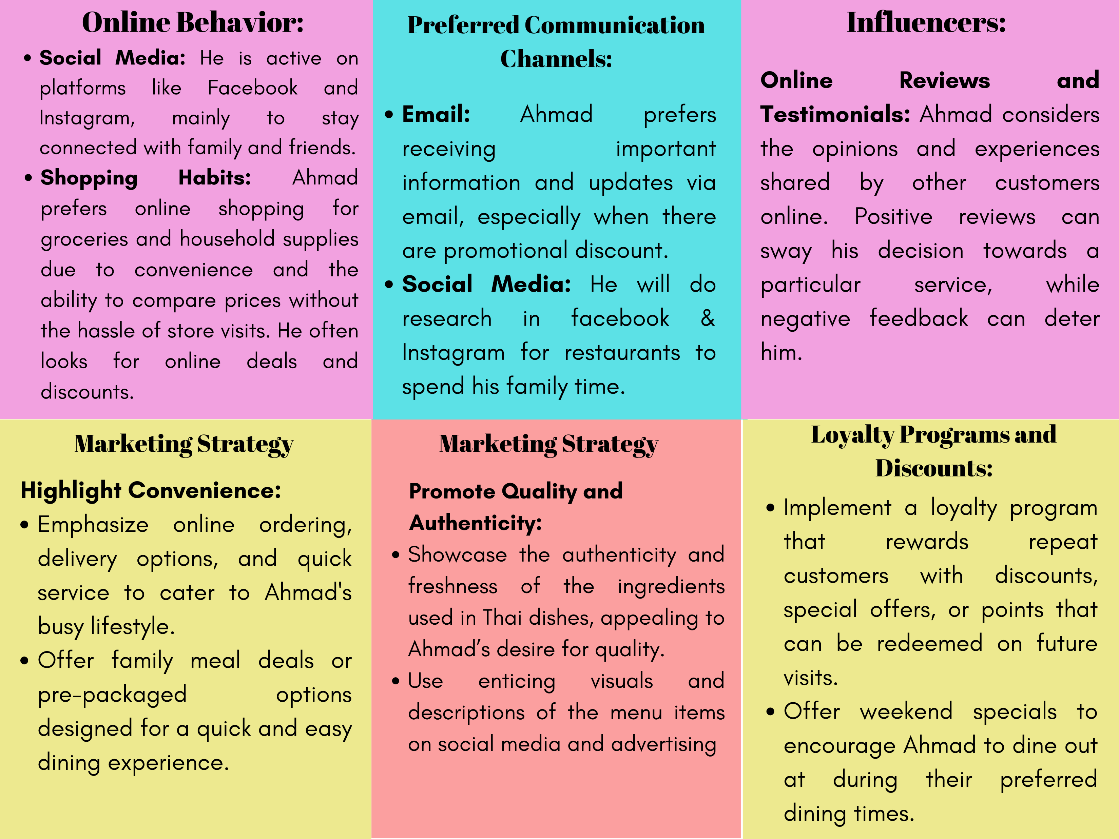
CUSTOMER PERSONA

Slide 13
SWOT Analysis of My Company
Strengths | Weaknesses
1. Authentic Cuisine: • Offers genuine Thai flavors and dishes that appeal to customers looking for authenticity. | 1. Limited Awarness: • If the restaurant is not widely known, it may struggle to attract new customers.
2. Specialization: • Focus on Thai cuisine can creae a strong brand identity, attracting customers specially looking for this type of food. | 2. Social Media • Limited engagement.
3. Convenience: • Takeout and delivery services cater to the growing demand for convenience in dining, particularly in urban areas. | 3. Marketing Budget: • Limited marketing budget make it challenging to reach your target audience.
4. Long Standing Business: • Has been in business for more than 10 years. | 4. Webiste Optimizing: • Picture is not high resolution and visual appealing.
5. Customize Food: • Customizing food to your need sets ThaiToGo apart from competitors. | 5. Operational Challenges: • Heavy consistent quality during peak times or scaling up for increased demand can be difficult.
6. Cultural Experience: • The combining of dining with cultural elements (like décor and music) enhances the overall customer experience.
Notes:
- *Strengths*:
- "ThaiToGo’s strengths include our authentic cuisine, strong brand identity, and the convenience of our delivery services. Our ability to customize meals sets us apart from competitors."
- *Weaknesses*:
- "However, we face challenges like limited brand awareness, low social media engagement, and operational difficulties during peak times."

Slide 14
SWOT Analysis of My Company
Opportunities | Threats
1. Unique Demand: • Offering customize dishes of Thai flavor. | 1. Intense Competition: • The food industry, especially the takeout segment is highly competitive with numerous options available to consumers.
2. Health-Concious Menu items: • Introducing healthier, low-calorie or dietary-specific options (like vegan or gluten-free) can attract a wider audience. | 2. Economic Factors: • Economic downturns can lead to decreased discretionary spending on dining out or ordering in.
3. Market Expansion: • Opportunities to expand into new geographic areas or open additional locations cater to untapped markets. | 3. Changing Consumer Preferences: • Shifts in consumer dietary trends or preferences can impact demand for certain types of cuisine.
4. Market Demand: • Target peak times, such as after prayer services or during special occasions, for promotions or special menus. | 4. Supply Chain Disruptions: • Relance on specific ingredients might lead to vulnerabilities if there are supply chain issues.
5. Digital Marketing: • Enhancing online presence and leveraging social media for targeted advertising can increase brand visibility. | 5. Health and Safety Regulations: • Increasing regulations around food safety, packaging and delivery can create operational challenges.
Notes:
- *Opportunities*:
- "There are opportunities to introduce health-conscious menu items, expand geographically, and enhance our digital marketing efforts to tap into new customer segments."
- *Threats*:
- "On the flip side, intense competition and potential supply chain disruptions could impact our growth. We must also stay ahead of changing consumer preferences and regulatory requirements."

Slide 15
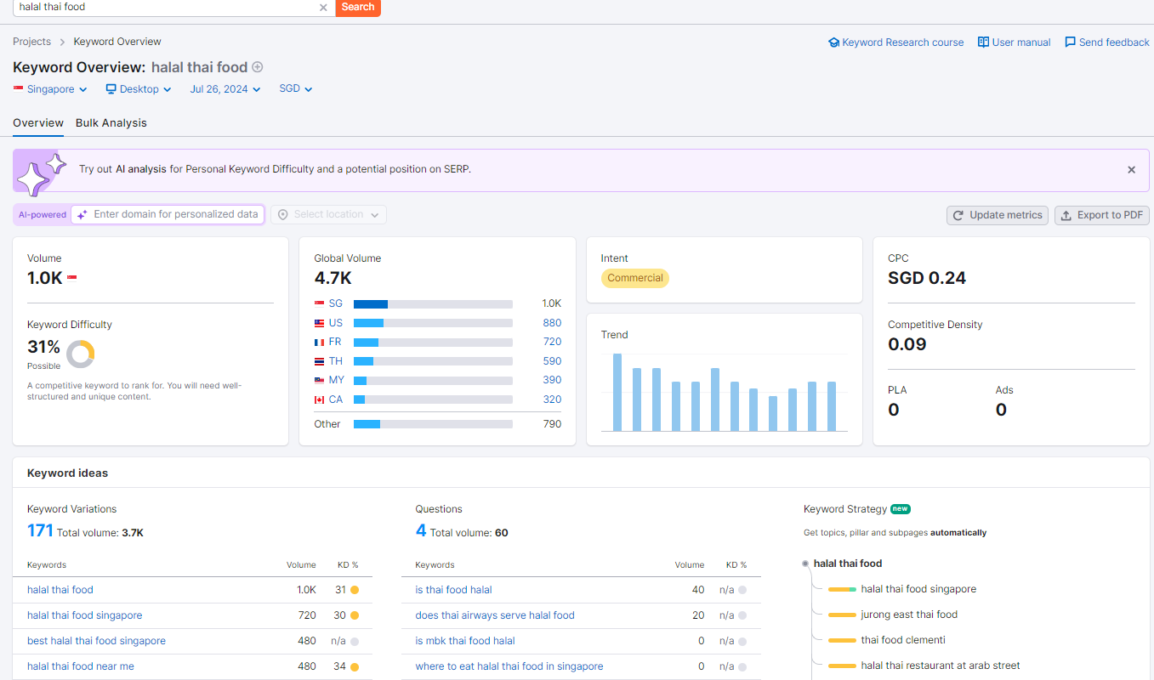
SEO STRATEGY
People are looking for Halal Thai Food in Singapore

Slide 16
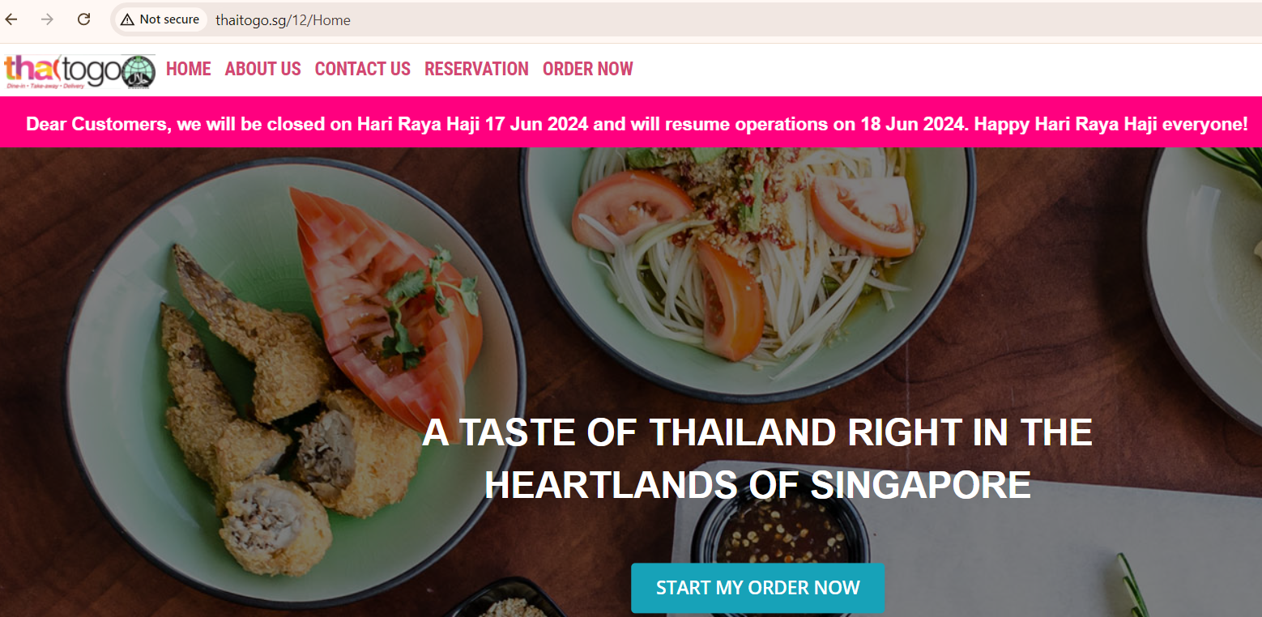
Competitive Analysis - Website
Showing Not secure website
Reason: A website that is not secure means that the connection between the website and your web browser is not encrypted. This means that any information you enter on the website, such as passwords, credit card numbers, or personal information, could potentially be intercepted by a third party.
Results: Customer may feel insecure when they want to order food and key in credit card details etc.
Website Promotion is not updated.
Its July but it still shows Hari Raya Haji promotion in June

Slide 17
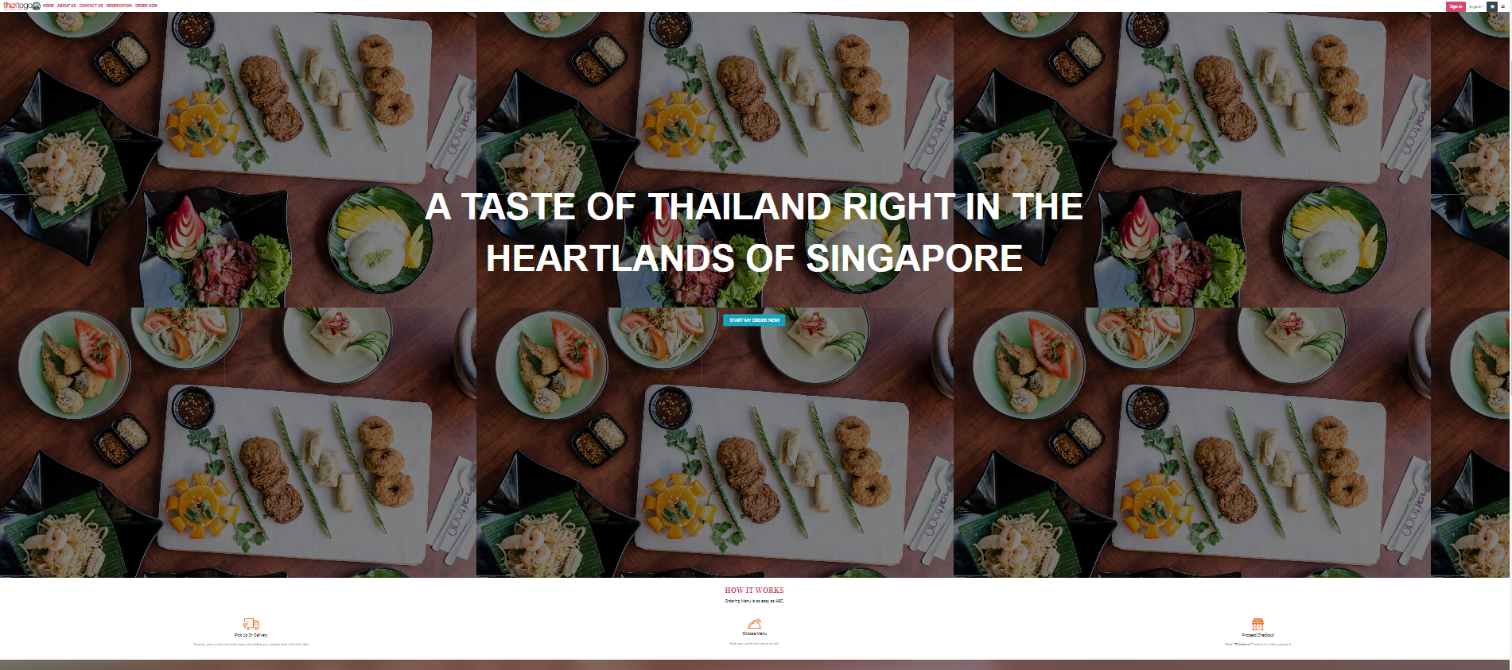
Competitive Analysis - Website
When you zoom in/out the website, the contents are not visible including Logo & contents.

Slide 18
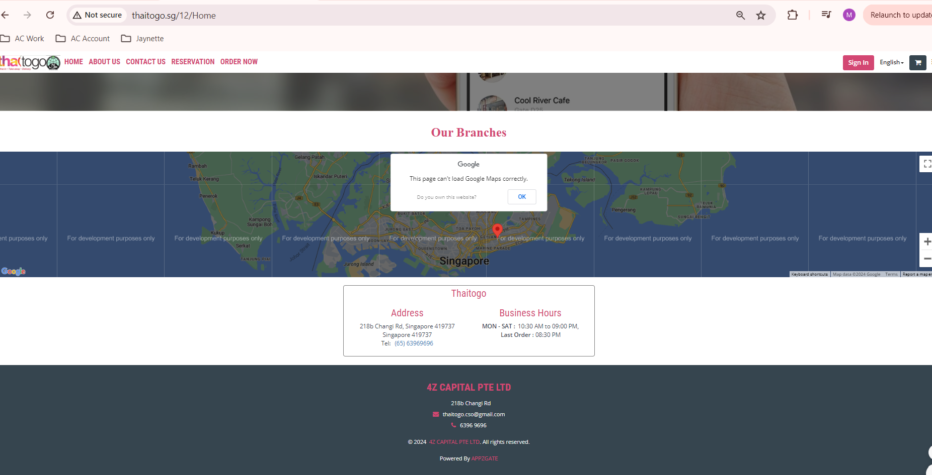
Google Map
cannot load
Duplicate
postal code

Slide 19
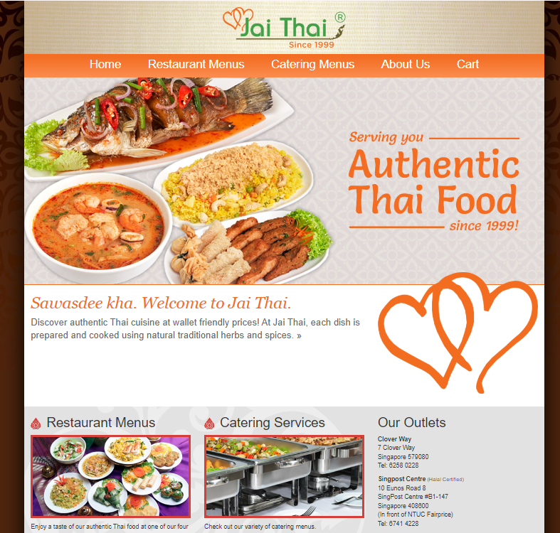
Competitive Analysis - Website
The website "Jai Thai" (https://www.jai-thai.com/) has a visually appealing design with clear navigation menus and a professional look.

Slide 20
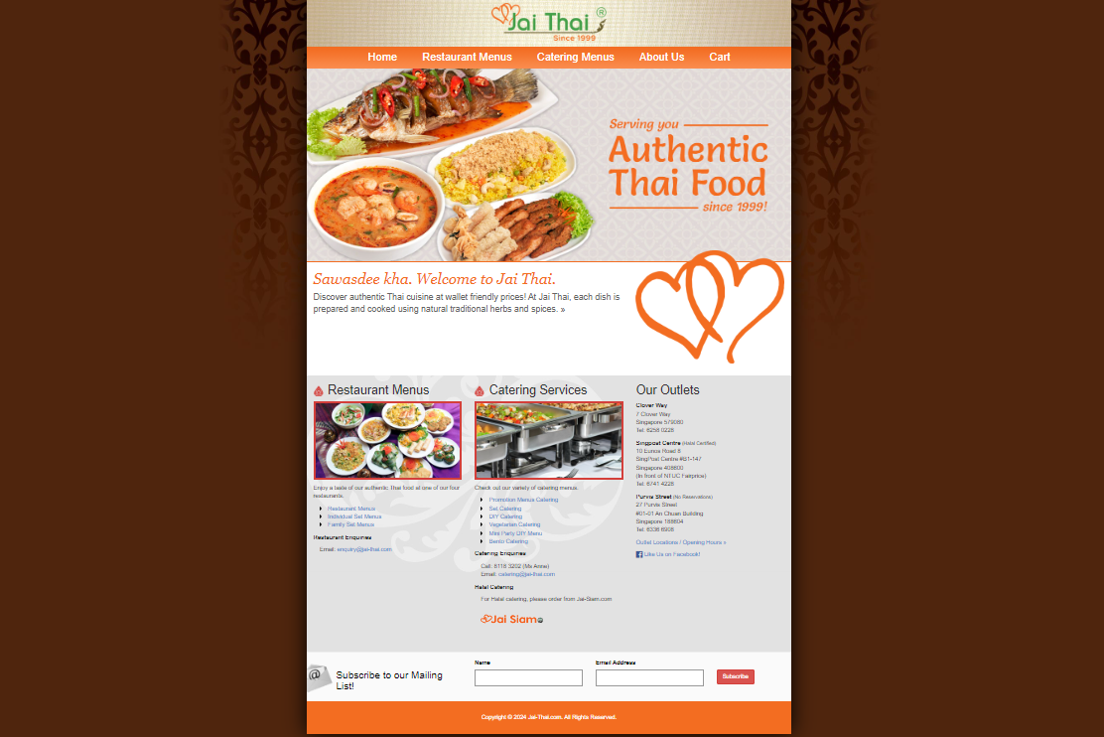
Competitive Analysis - Website
For example, Jai Thai website serves as a competitor. When you zoom in or out, the content on the landing page remains visible.

Slide 21
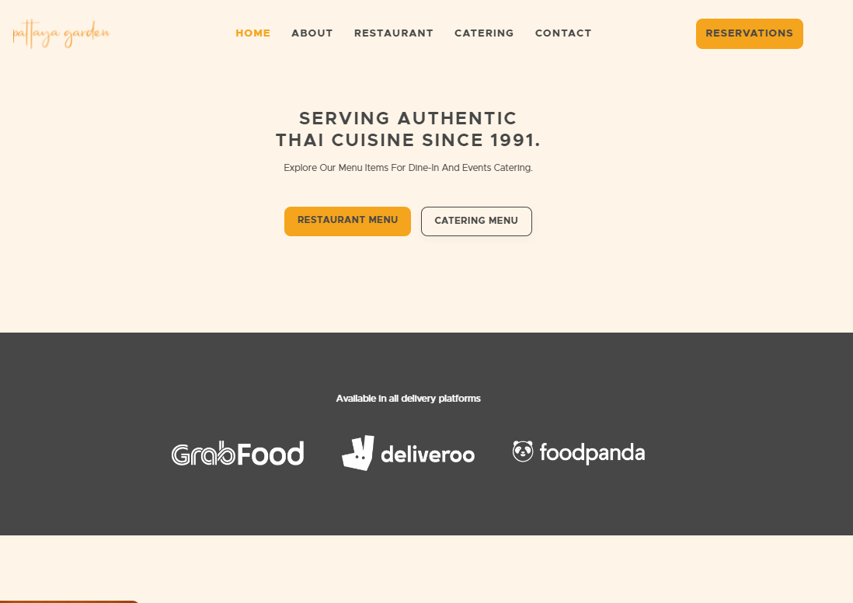
Competitive Analysis - Website
The website "Pattaya Garden" (https://www.pattayagarden.com.sg/restuarant-menu) has a simple and straightforward design, but it may benefit from a more modern and visually engaging layout.

Slide 22
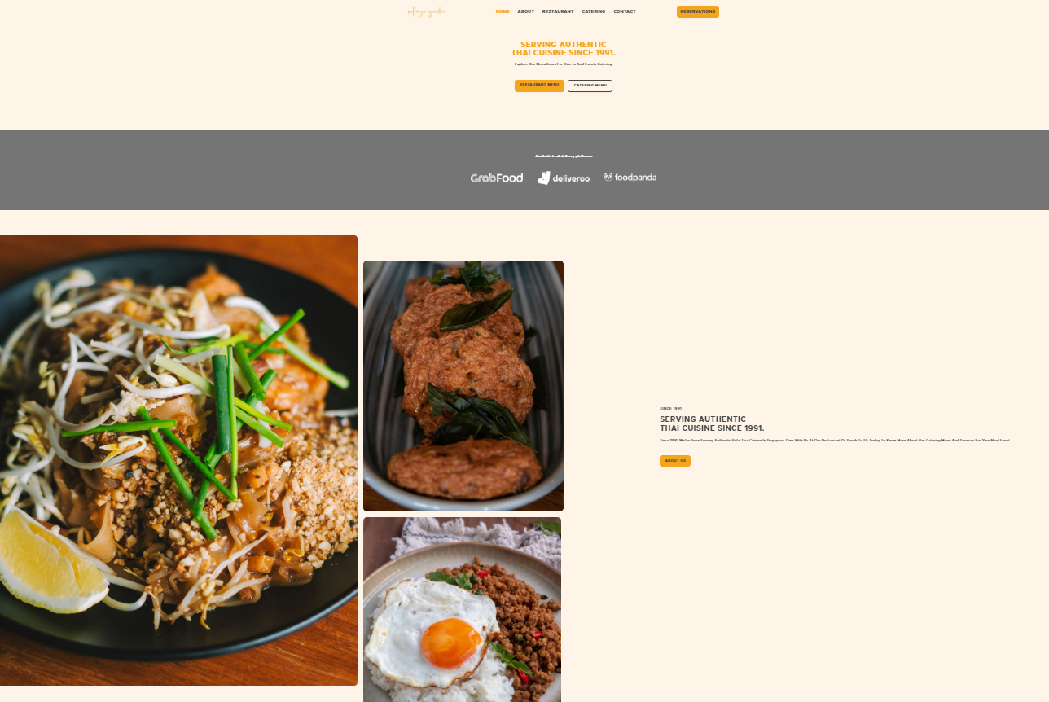
Competitive Analysis - Website
Pattaya Garden Restaurant has similar issues with ThaiToGo.
The Fonts is too small when you zoom in.

Slide 23
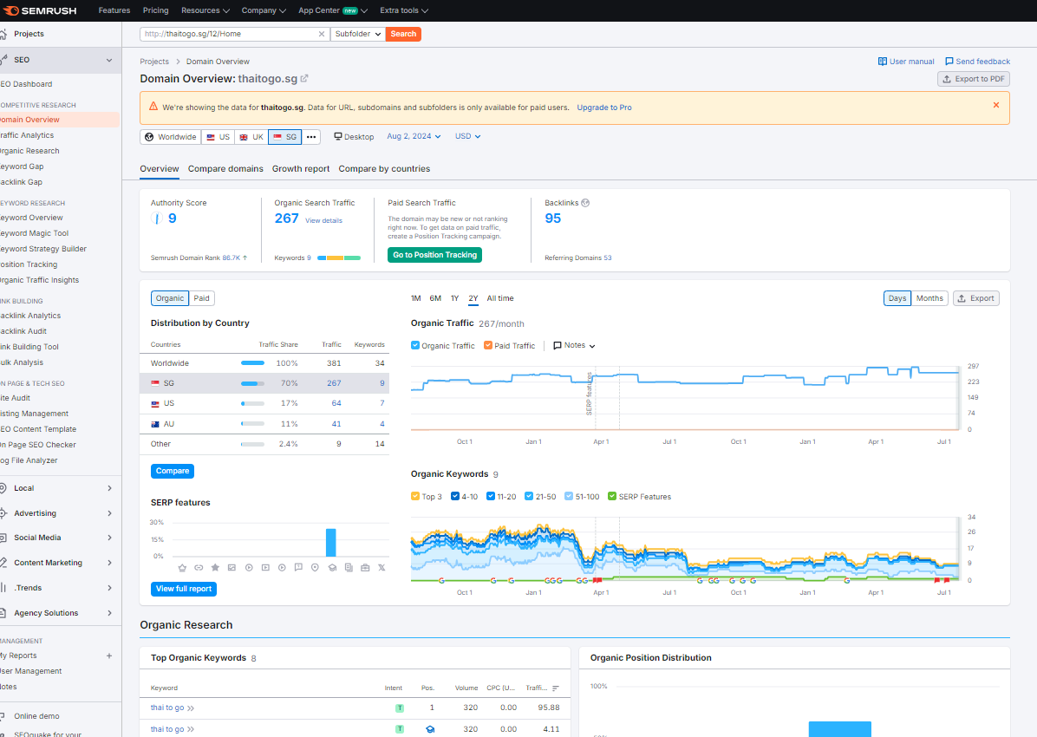
ThaiToGo
Competitive Analysis - Website
Traffic showing 267

Slide 24
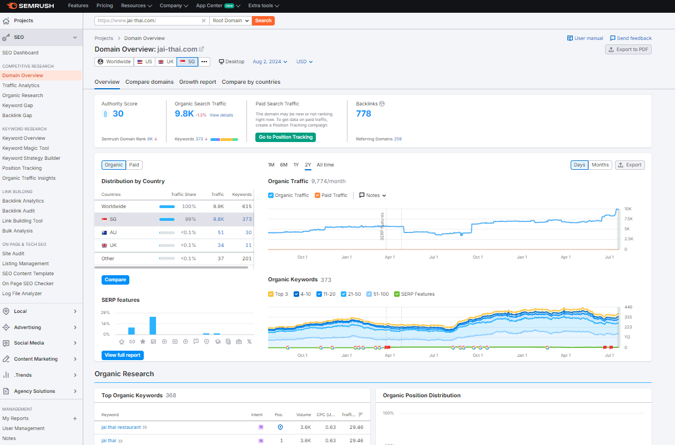
Jai Thai
Competitive Analysis - Website
High Traffic showing 9.8k

Slide 25
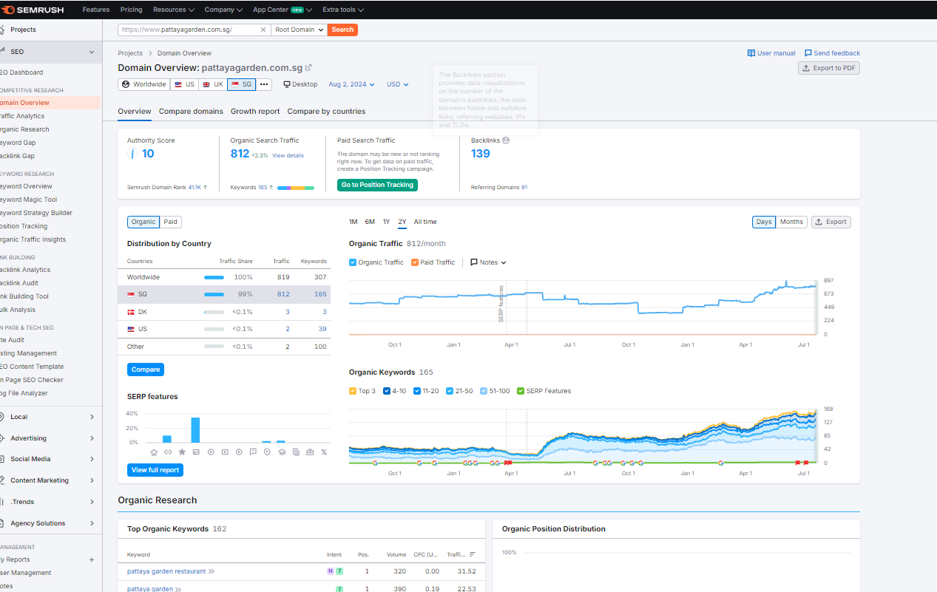
Pattaya Garden
Competitive Analysis - Website
Traffic showing 812

Slide 26
MARKETING STRATEGY - OPTIMIZING WEBSITE
Restaurant | ThaiToGo | Jai Thai | Pattaya Garden
Menu Presentation: | They presents its menu in a simplified format, making it easy to browse through available options quickly. | They have a well-organized menu section with clear categories and detailed descriptions of dishes. | Showcases its menu items with images and descriptions, giving customers a visual representation of what they can expect to order.
Online Ordering Functionality: | They provides online ordering options as well, allowing users to select their desired dishes and complete the ordering process online. | The website offers online ordering functionality, making it convenient for customers to place orders directly through the site. | They does not have online ordering capability on its website, which may require customers to place orders through other means.
Promotions and Special Offers: | The websites display promotions and special offers prominently on their homepages, attracting customers with discounts and deals. | The websites display promotions and special offers prominently on their homepages, attracting customers with discounts and deals. | The website lacks a visible promotion or special offers section, potentially missing out on the opportunity to engage customers with special deals.
Notes:
- *Website Optimization*:
- "To improve our digital presence, we need to optimize our website for SEO, ensuring it is mobile-friendly and easy to navigate. An updated and secure online ordering system is crucial."

Slide 27
MARKETING STRATEGY OPTIMIZING WEBSITE
Visual Appeal and Branding: | Menu Presentation and Descriptions: | Mobile Responsiveness: | Online Ordering Experience: | Promotions and Special Offers: | Social Media Integration: | Customer Feedback and Reviews:
• Update the website design to create a more visually appealing and modern look that aligns with the brand's identity and target audience. • Use high-quality images of food items and the restaurant to enhance the visual impact and entice visitors to explore the menu further. | • Revamp the menu layout to make it more visually engaging and user-friendly, with clear categories and appetizing images of dishes. • Improve the descriptions of menu items to provide more detailed information about ingredients, flavors, and preparation methods to help customers make informed choices. | • Ensure that the website is optimized for mobile devices to provide a seamless and user-friendly experience for customers browsing on smartphones and tablets. • Test the website's responsiveness on different screen sizes and devices to ensure consistent performance across various platforms. | • Streamline the online ordering process to make it intuitive and efficient for customers to select dishes, customize their orders, and complete transactions seamlessly. • Implement features like order tracking, secure payment options, and account creation to enhance the overall online ordering experience. | • Highlight promotions, daily specials, and discounts prominently on the homepage to attract customers' attention and encourage them to explore the menu further. • Create a dedicated section for promotions, events, and seasonal offerings to engage customers and drive repeat visits. | • Integrate social media platforms with the website to facilitate social sharing, customer engagement, and feedback collection. • Display social media feeds, reviews, and testimonials on the website to build trust and credibility among visitors. | • Include a section for customer reviews and testimonials to showcase positive feedback from satisfied customers and build credibility for the restaurant. • Encourage customers to leave reviews and ratings after ordering to gather valuable feedback and insights for continuous improvement.
Notes:
- *Social Media Strategy*:
- "We will enhance our social media engagement by creating high-quality content, including professional food photography and behind-the-scenes videos. Collaborating with influencers and using targeted ads will help us reach a broader audience."
- *Customer Engagement*:
- "We plan to implement loyalty programs and promote customer reviews to build trust and encourage repeat business. Engaging with customers through polls and challenges will also be key to maintaining a vibrant community around our brand."

Slide 28
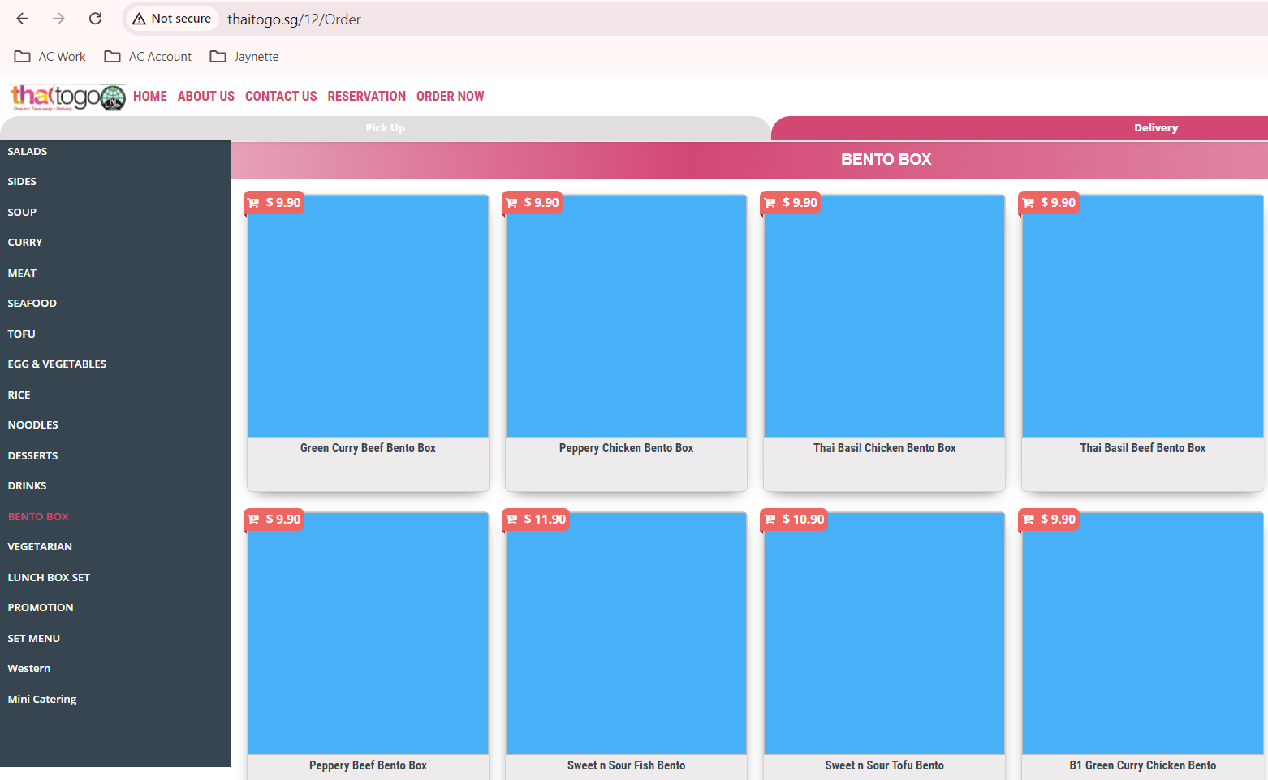
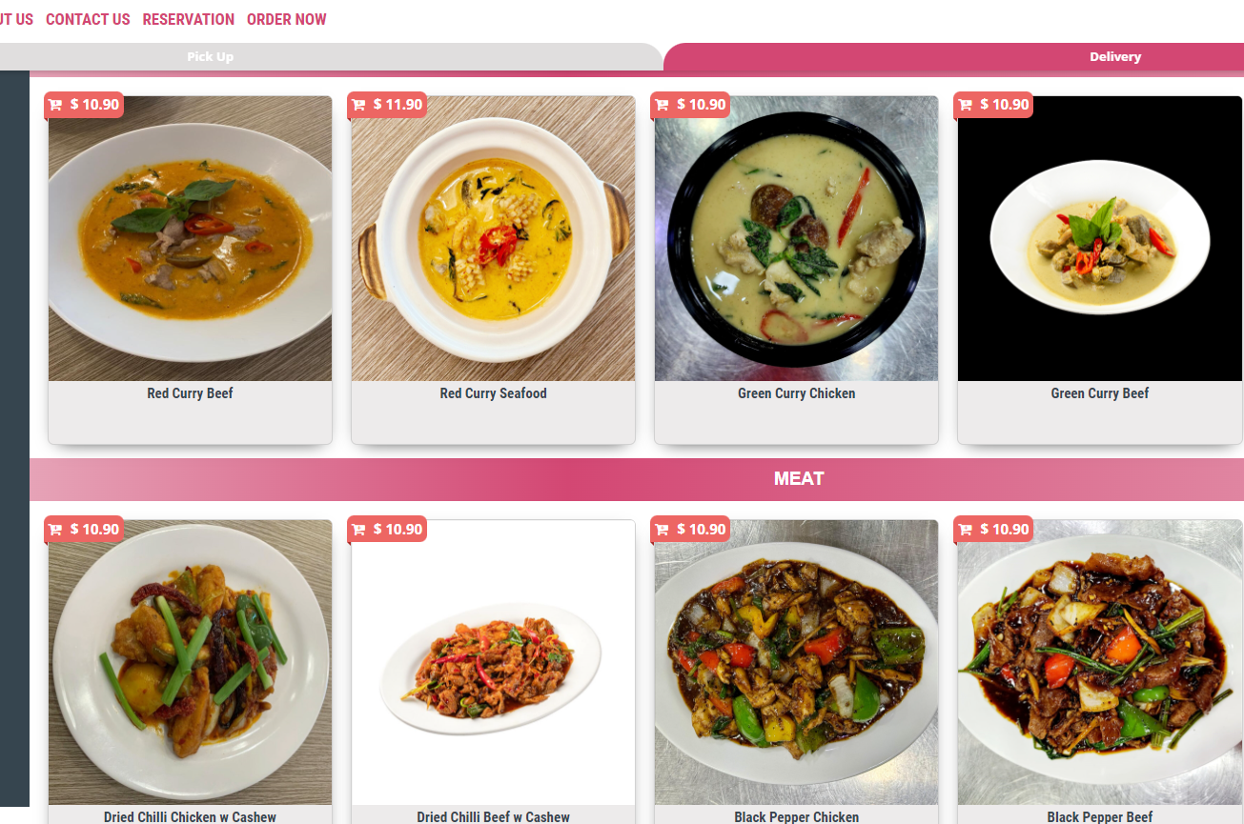
Missing photos
Not visual appealing
MARKETING STRATEGY
OPTIMIZING WEBSITE

Slide 29
MARKETING STRATEGY - WEBSITE
SEO Optimization | Optimize your website for search engines using keywords related to Thai cuisine and restaurants in Singapore. This will help attract organic traffic.
User-Friendly Design | Ensure that the website is mobile-friendly and easy to navigate. Include a clear menu, contact information, and an online reservation system.
Online Ordering System | Implement an easy-to-use online ordering system for takeout or delivery, optimizing customer experience and convenience.
Blog & Recipes | Create a blog section featuring articles on Thai cuisine, cooking tips, or recipes that resonate with your audience. This can boost SEO and establish the restaurant as an authority in Thai cuisine.
Customer Reviews | Include a testimonial section to showcase positive customer experiences and reviews to build credibility.

Slide 30
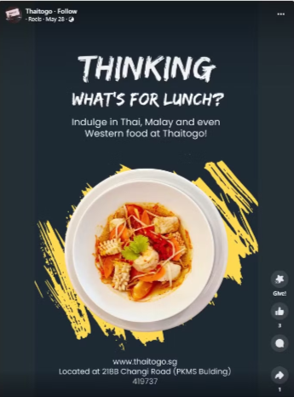
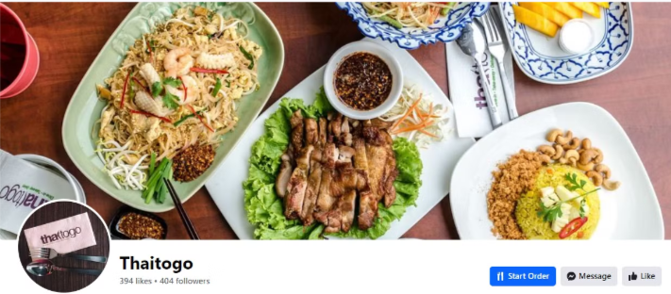
COMPETITIVE ANALYSIS - FACEBOOK
ThaiToGo Restaurant
They are located at Changi Road.
They have restaurants for Dine-in and catering services.
They have 404 followers, but last post was in May.

Slide 31
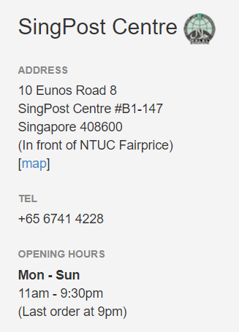
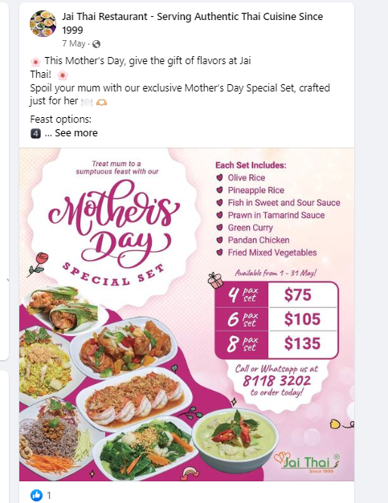
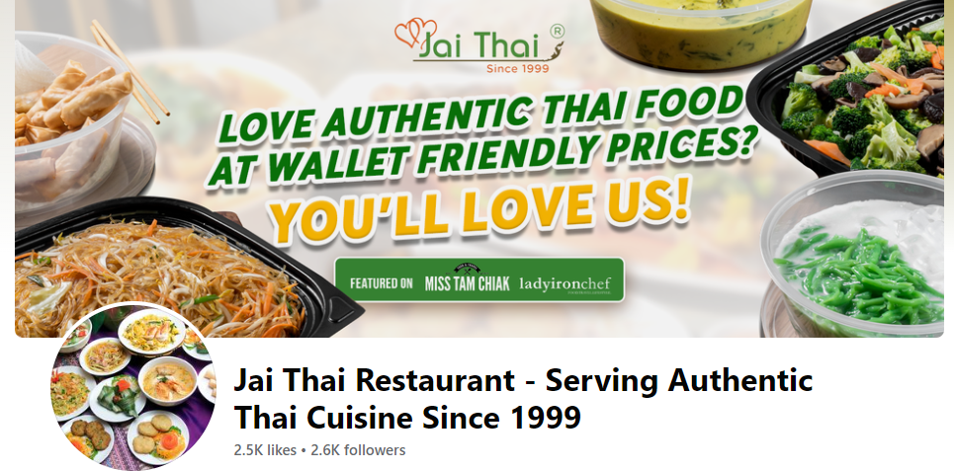
COMPETITIVE ANALYSIS - FACEBOOK
Jai Thai Restaurant
They have 4 branches in Singapore.
The nearest branch is at Eunos Singpost.
They have restaurants for dine-in and catering services.
They have 2.6k followers but last post was May for Mother’s Day special set.

Slide 32
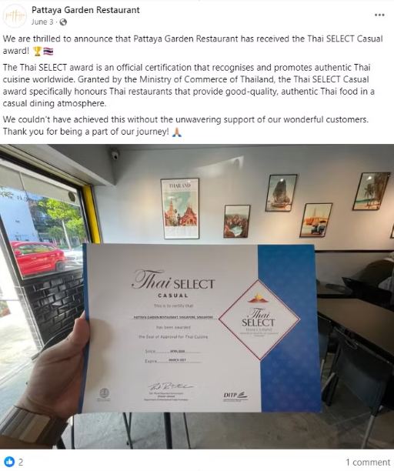
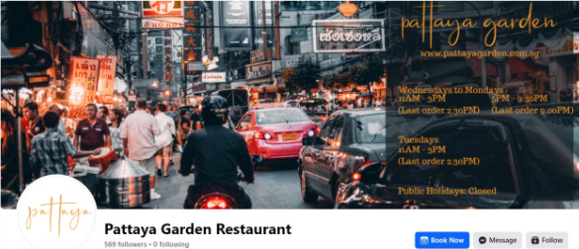
COMPETITIVE
ANALYSIS - FACEBOOK
Pattaya Garden Restaurant
They have been awarded by Thai Select.
They are located at Changi Road.
They have restaurants for Dine-in and catering services.
They have 569 followers, but last post was in June.

Slide 33
COMPETITIVE ANALYSIS - FACEBOOK
Comparison Table
Restaurant Name | Followers | Following | Likes | Reviews | Recommend
ThaiToGo Restaurant | 394 | 405 | 394 | Not Yet Rated | Not Yet Rated
Jai Thai Restaurant | 2,600 | Not Yet Rated | 2,500 | 230 | 72%
Pattaya Garden Restaurant | 567 | 0 | Not Yet Rated | 77 | 76%
ThaiToGo has 394 Followers but No reviews and No recommendation
Jai Thai Shows has 2,600 Followers (Highest) with 230 Reviews and 72% Recommendation
Pattaya Garden has 567 Followers with 77 Reviews but highest Recommendation at 76%

Slide 34
MARKETING STRATEGY - FACEBOOK
Engaging Content | Share behind-the-scenes videos of food preparation, staff highlights, or daily specials. Use live videos for cooking demonstrations or Q&A sessions.
Targeted Ads | Utilize Facebook Ads to reach specific demographics, such as young professionals or families in Singapore who enjoy Thai cuisine. Use geo-targeting to focus on nearby neighborhoods.
Customer Engagement | Create polls, challenges, or themed contests (e.g., best photo of a dish) to engage your audience and encourage sharing.
Community Involvement | Promote local events or causes that the restaurant supports or participates in, creating strong community ties.
Reviews and User-Generated Content | Encourage customers to leave reviews and share their dining experiences. Feature these on your page to build trust and attract new customers.
Event Promotion | Use the Events feature to promote special events, such as Thai festival celebrations, cooking classes, or tasting nights.

Slide 35
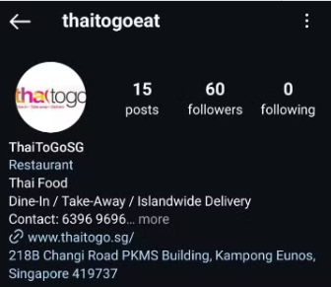
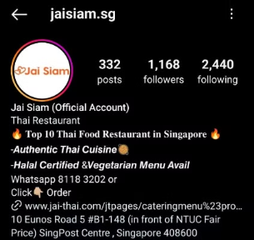
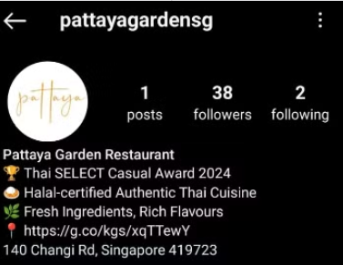
COMPETITIVE ANALYSIS - INSTAGRAM
Comparison Table
Restaurant Name | Followers | Following | Post
ThaiToGo Restaurant | 60 | 0 | 15
Jai Thai Restaurant | 1,168 | 2,440 | 332
Pattaya Garden Restaurant | 38 | 2 | 1
Jai Thai
has the highest Followers & post

Slide 36
MARKETING STRATEGY - INSTAGRAM
High-Quality Imagery | Invest in professional photography to showcase your dishes. Use natural lighting to highlight the colors and textures of the food.
Instagram Stories & Highlights | Use Stories for daily specials, new menu items, or behind-the-scenes content. Save important stories as Highlights for easy access to information about your offerings.
Influencer Collaborations | Partner with local food influencers to reach a wider audience. Offer them a complimentary meal in exchange for a feature on their page.
Hashtags | Use relevant hashtags not only related to Thai food but also popular Singaporean hashtags to expand your reach (e.g., #Halal, #FoodNearby)
Engagement | Respond to comments and direct messages promptly. Engage with customers’ posts who tag the restaurant.

Slide 37
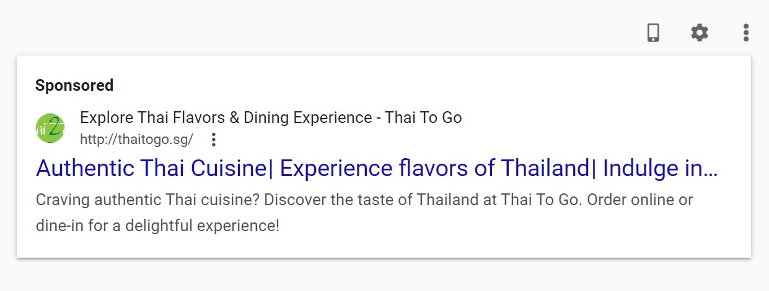
COMPETITIVE ANALYSIS
SEARCH ENGINE MARKETING

Slide 38
Market Strategy
ThaiToGo is a Thai restaurant offering Authentic Thai cuisine with a modern twist. Our goal is to become the go-to place for Thai food lovers in the area. This marketing plan outlines our strategy to increase brand awareness, attract new customers, and build a loyal customer base.
Awareness Stage
Marketing Campaigns | Utilize social media, local advertising, and community events to promote Thaitogo.
Content Marketing | Share engaging content such as authentic Thai recipe videos, food photography, and customer testimonials through online platforms and blogs.
SEO and Online Presence | Optimize your website and social media profiles to appear in search engine results for relevant keywords (e.g., "Thai restaurant near me," “Halal Thai food").

Slide 39
Consideration Stage
Menu Showcase | Highlight your unique dishes with detailed descriptions and appealing visuals to pique interest.
Reviews and Testimonials | Encourage satisfied customers to leave positive reviews on platforms like Google, Facebook and Instagram to build credibility.
Promotions | Offer introductory discounts or special deals to entice first-time visitors to try out your restaurant.
Decision Stage
Seamless Booking and Ordering | Ensure that online reservations and take-out orders are straightforward and user-friendly.
Loyalty Programs | Implement a rewards system to incentivize repeat visits, such as discounts on future meals or loyalty points.
Efficiency | Encourage staff to work quickly and efficiently to minimize wait times and improve overall service quality.

Slide 40
Marketing Prioritization
 | High Cost To Execute | Low Cost To Execute
High Impact | Influencer Marketing Description: Collaborating with influencers who have a strong following in your target market. Impact: Can rapidly increase brand visibility and credibility, driving conversions. | Targeted Ads and Promotion Description: Running highly targeted Facebook, Instagram, Tik Tok that reach specific demographics or interest groups. Impact: Increases brand visibility and drives traffic or conversions by putting your brand in front of the right audience.
Low Impact | Basic Social Media Posts Description: Regular updates or promotional posts without a strategic focus. Impact: May engage a small audience but often lacks the depth needed for significant impact. | Referral Programs: Implementing programs that encourage existing customers to refer new clients with minimal costs. Impact: When incentives are weak, customers are less likely to participate, leading to a low number of referrals.

Slide 41
Customer Journey
Customer Lifestyle Stage | Digital Marketing Channels | Content Ideas (copywritten titles)
Awareness | Social Media (Instagram, Facebook) SEO (Local SEO) Influencer Partnerships Paid Advertising (Google Ads, Social Media Ads) | "Taste the Authentic Flavors of Thailand!": Create captivating social media posts featuring mouth-watering images of signature dishes, inviting followers to experience the essence of Thai cuisine. "Savor Every Bite!": Use eye-catching ads with enticing visuals and compelling copy to draw in new customers, highlighting special promotions or new menu items.
Consideration | Website (Landing Pages) Online Reviews and Testimonials Social Media Engagement | "Explore Our Menu: A Taste of Thailand Awaits!": Craft detailed descriptions of each dish on the website, emphasizing unique flavors and ingredients to entice potential diners. "What Our Customers Are Saying!": Feature glowing testimonials and reviews prominently on social media and the website, building trust and credibility.
Decision | Retargeting Ads Website (Online Ordering) Loyalty Programs | "Limited-Time Offer: Taste the Magic of Thailand!": Promote special discounts or meal deals with urgency-driven copy to encourage immediate action. "Join Our Loyalty Family!": Highlight the benefits of joining a loyalty program with enticing copy that emphasizes rewards and exclusive offers.

Slide 42
Marketing Funnel
Attention
01
Social Media (Facebook, Instagram), Google Ads, SEO
Interest
02
Email Marketing, Retargeting Ads, Website Content
Desire
03
Social Media (Instagram Stories, Facebook Events), Influencer Partnerships
04
Action
Website, WhatsApp, Phone Calls

Slide 43
Marketing Funnel
Attention
Channels:
Social Media (Facebook, Instagram)
Google Ads
SEO
Content:
"Taste the Authentic Flavors of Thailand!": Create captivating social media posts featuring mouth-watering images of signature dishes, inviting followers to experience the essence of Thai cuisine.
"Savor Every Bite!": Use eye-catching ads with enticing visuals and compelling copy to draw in new customers, highlighting special promotions or new menu items.
2. Interest
Channels:
Retargeting Ads
Website Content
Content:
Retargeting Ads: "Explore Our Menu: A Taste of Thailand Awaits!": Craft detailed descriptions of each dish on the website, emphasizing unique flavors and ingredients to entice potential diners.
Website Content: Detailed descriptions and high-quality images of popular dishes, customer testimonials, and reviews.

Slide 44
Marketing Funnel
3. Desire
Channels:
Social Media (Instagram Stories, Facebook Events)
Influencer Partnerships
Content:
Instagram Stories: "Watch our chef prepare our signature Green Curry!"
Facebook Events: "Join our Thai Food Challenges – Who can eat the spiciest food!"
Influencer Partnerships: Local food influencers sharing their dining experience at ThaiToGo.
4. Action
Channels:
Website
WhatsApp
Phone Calls
Content:
Website: "Order Online Now for Fast Delivery!"
WhatsApp: "Place your order via WhatsApp for a quick and easy experience."
Phone Calls: "Call us to make a reservation or place a takeout order."

Slide 45
SMART Goals
Channel | Metric | KPI | Duration | Notes (if any)
Landing Page | Conversion rate | +15% | in 3 months time | Optimize the landing page with compelling content and a clear call to action (CTA)
Website | Online orders | +20% | in 3 months time | Improve user experience on the website, making it easier for customers to place orders. Promote online ordering through social media and email campaigns.
Social Media (Facebook) | Number of followers | +25% | in 3 months time | Focus on engaging posts and Facebook Ads targeting food lovers. Share content like customer testimonials, behind-the-scenes, and promotions.
Social Media (Instagram) | Engagement rate (likes, comments, shares) | +10% | in 3 months time | Utilize high-quality images and Instagram Stories. Engage with followers through interactive content like polls and Q&A sessions.

Slide 46
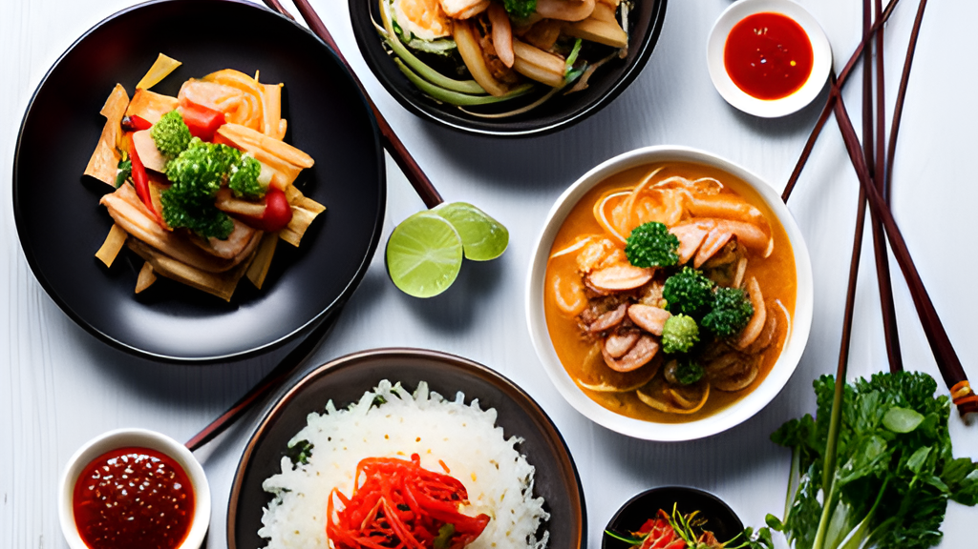
MARKETING EXECUTION

Slide 47
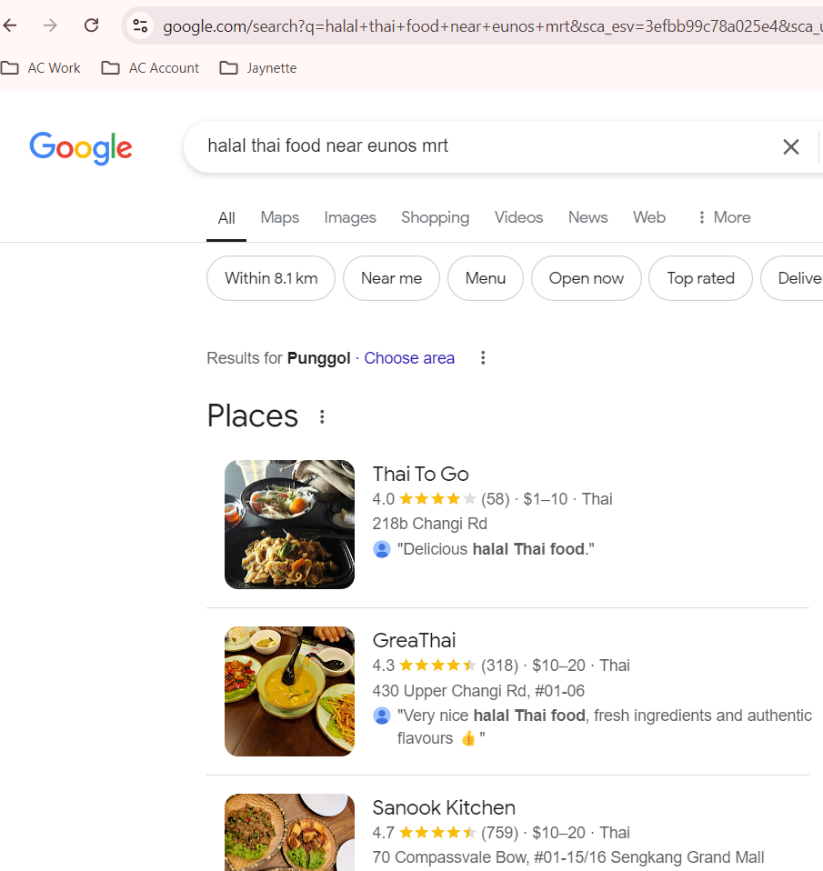
SEM – Google Search Ads

Slide 48
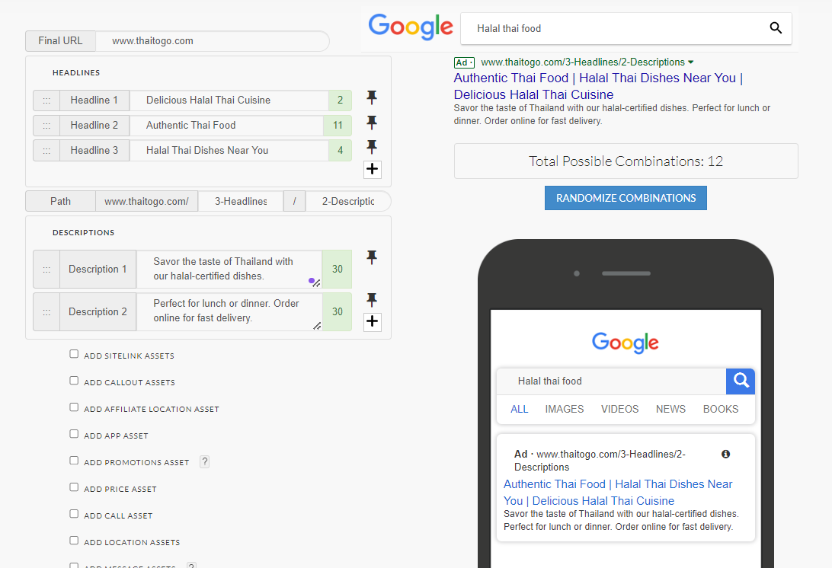
SEM – Google Search Ads (Ads Mockup)

Slide 49
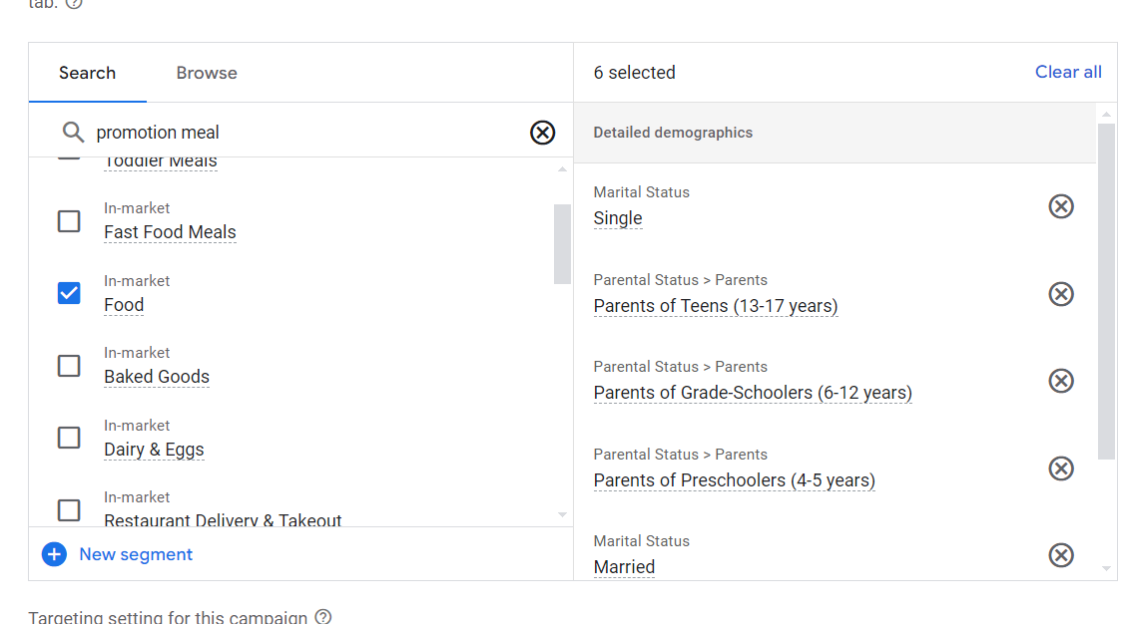
SEM – Google Search Ads (Target Audience)

Slide 50
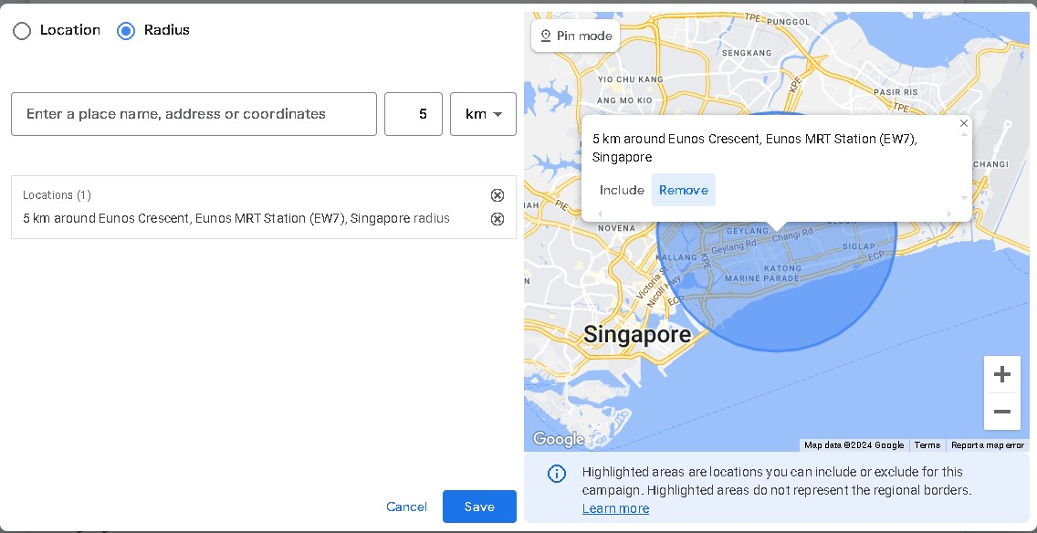
SEM – Google Search Ads (Target Audience)

Slide 51
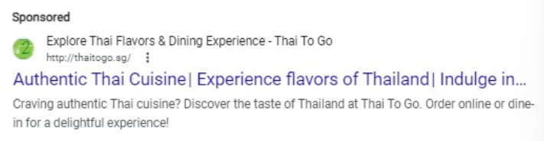
SEM – Google Search Ads

Slide 52
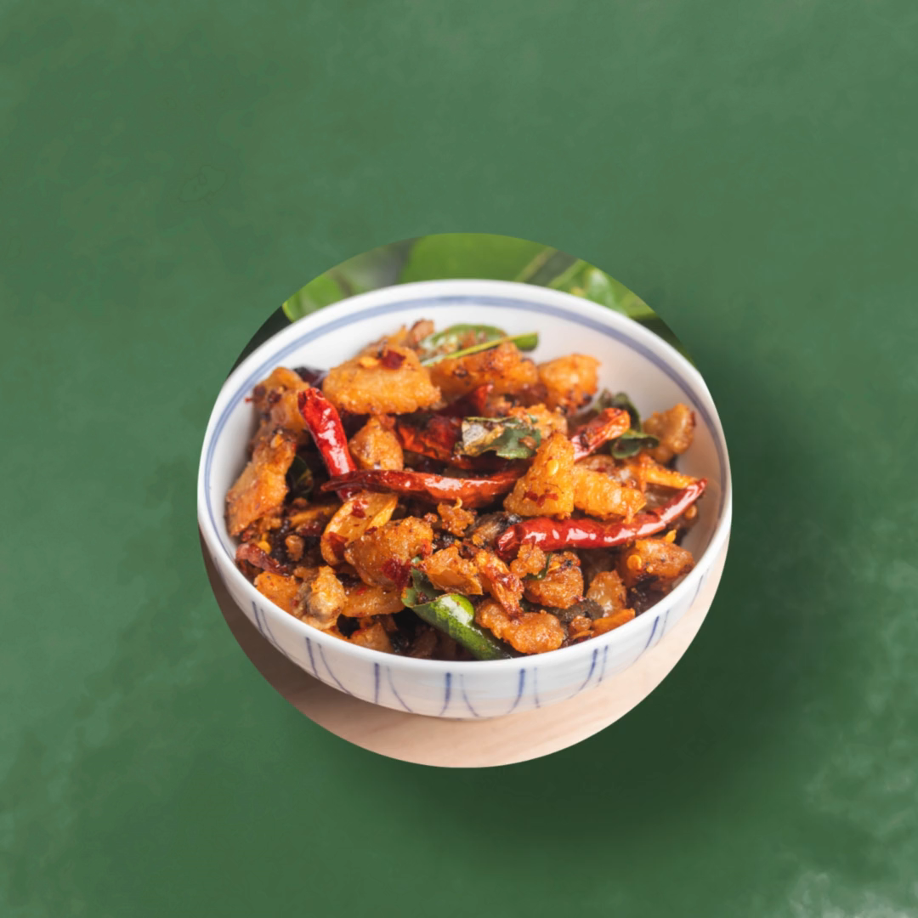
SEM – Google Display Network Ads (Target Audience)

Slide 53
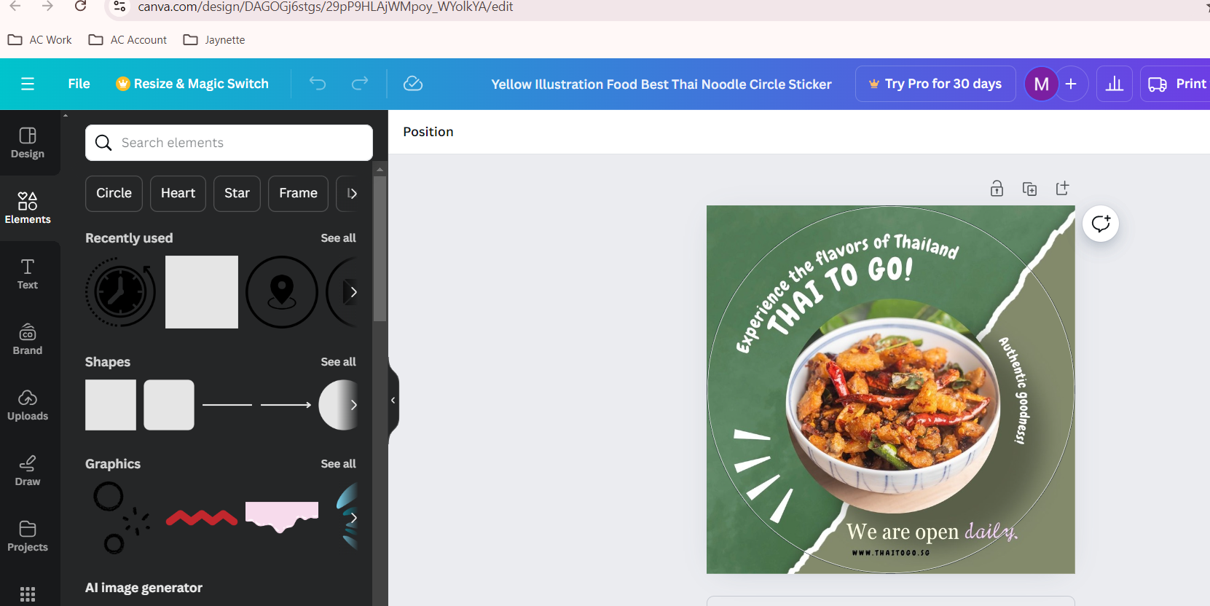
SEM – Google Display Ads

Slide 54
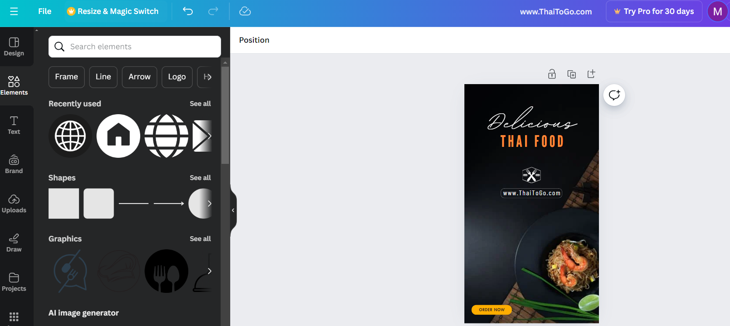
SEM – Google Display Ads

Slide 55
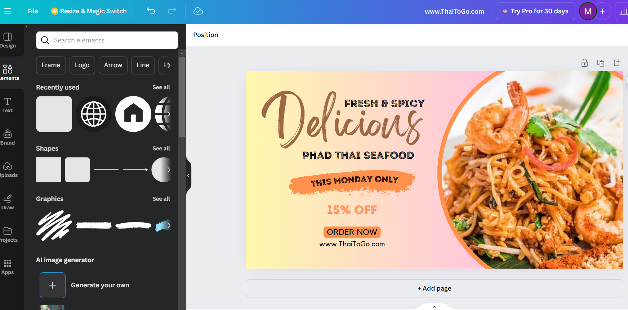
SEM – Google Display Ads

Slide 56
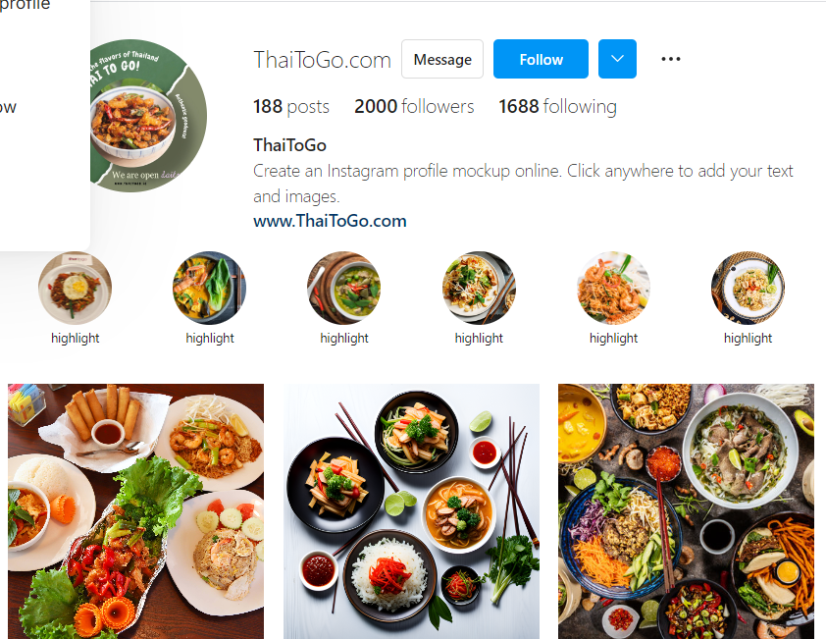
Social Media Marketing
(Instagram)

Slide 57
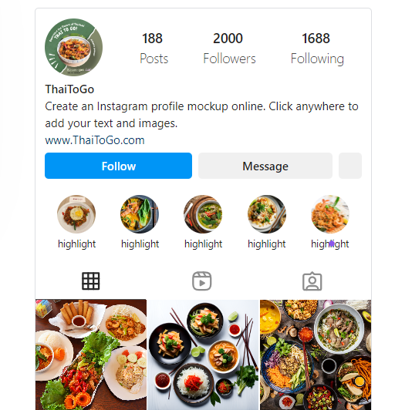
Social Media Marketing
(Instagram)

Slide 58
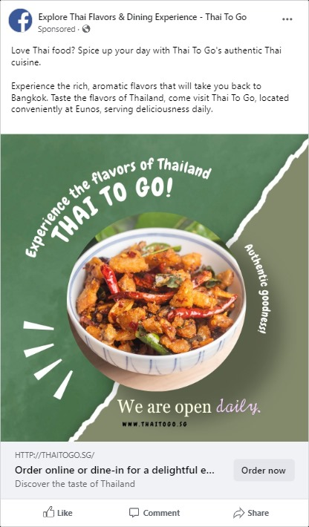
Social Media Marketing
(Facebook)

Slide 59
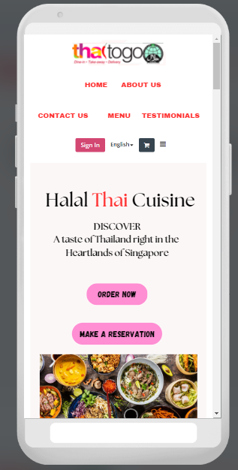

Landing Page

Slide 60

Sample of my Landing Page
Visual Appearing & Modern Page
High Quality Food Images
Improve the descriptions of menu items to provide more detailed information about ingredients, flavours, and preparation methods to help customers make informed choices.
Streamline the online ordering process to make it intuitive and efficient for customers to select dishes, customize their orders, and complete transactions seamlessly.
Highlight promotions, daily specials, and discounts prominently on the homepage to attract customers' attention and encourage them to explore the menu further.
Integrate social media platforms with the website to facilitate social sharing, customer engagement, and feedback collection.
Include a section for customer reviews and testimonials to showcase positive feedback from satisfied customers and build credibility for the restaurant.

Slide 61

Landing Page – Desktop

Slide 62

Landing Page – Desktop

Slide 63

Landing Page – Desktop

Slide 64

Landing Page – Desktop

Slide 65

Landing Page – Desktop

Slide 66




Landing Page – Mobile

Slide 67




Landing Page – Mobile

Slide 68
Email Marketing
S/N | Content of Email | Call To Action
1 | Friends & Family Feast Gather your loved ones! Order at least 4 set meal and get 10% off your total bill, making every meal a celebration! | "Order Now for Family & Friends Savings!"
2 | Birthday Celebration Celebrate with us! Sign up for our Members and enjoy a Complimentary dessert and 15% off your meal during your Actual Day! | "Sign Up for Birthday Treats Today!"
3 | Weekday Lunch Specials Enjoy a delicious lunch combo every weekday! Get 10% off any lunch special ordered before 2 PM! | "Grab Your Lunch Special – Order Now!"
4 | Seasonal Specials at a Discount Try our limited-time seasonal dishes at 15% off when you order as part of a combo! | "Don’t Miss Our Seasonal Special – Order Today!"
5 | Social Media Follow Reward Follow us on social media and receive a dessert when providing feedback! | "Follow Us for Exclusive Rewards!"

Slide 69

Email Marketing

Slide 70

Email Marketing

Slide 71
Final Thoughts:
- "In conclusion, ThaiToGo is well-positioned to capture a larger share of the market with our authentic offerings and strategic improvements. By optimizing our digital presence and engaging more deeply with our customers, we can achieve our ambitious growth targets."
Call to Action:
- "I invite all of you to support these initiatives as we take ThaiToGo to new heights. Together, we can make this restaurant the go-to place for Thai cuisine in Singapore."
This structure should provide a comprehensive yet concise presentation that addresses key areas for improvement and future growth for ThaiToGo.

Slide 72

Different
Address?

Slide 73

Shows in Foodline catering for min. 20 pax. Was informed that can only cater up to 10 pax due to license issue?

